Slide 1
Optimization for a Better Education
Sophie Chan, Andrew Ebert, Jordan Lauritzen

Slide 2
Question: How many professors should our school hire?

Slide 3
Constraints
Ratio
Class
Best Student-to-Teacher ratio
Number of Classes Needed per Semester
Budget
Non-Zero Integers
Budget for Professor Salary
Can’t have part of a professor

Slide 4
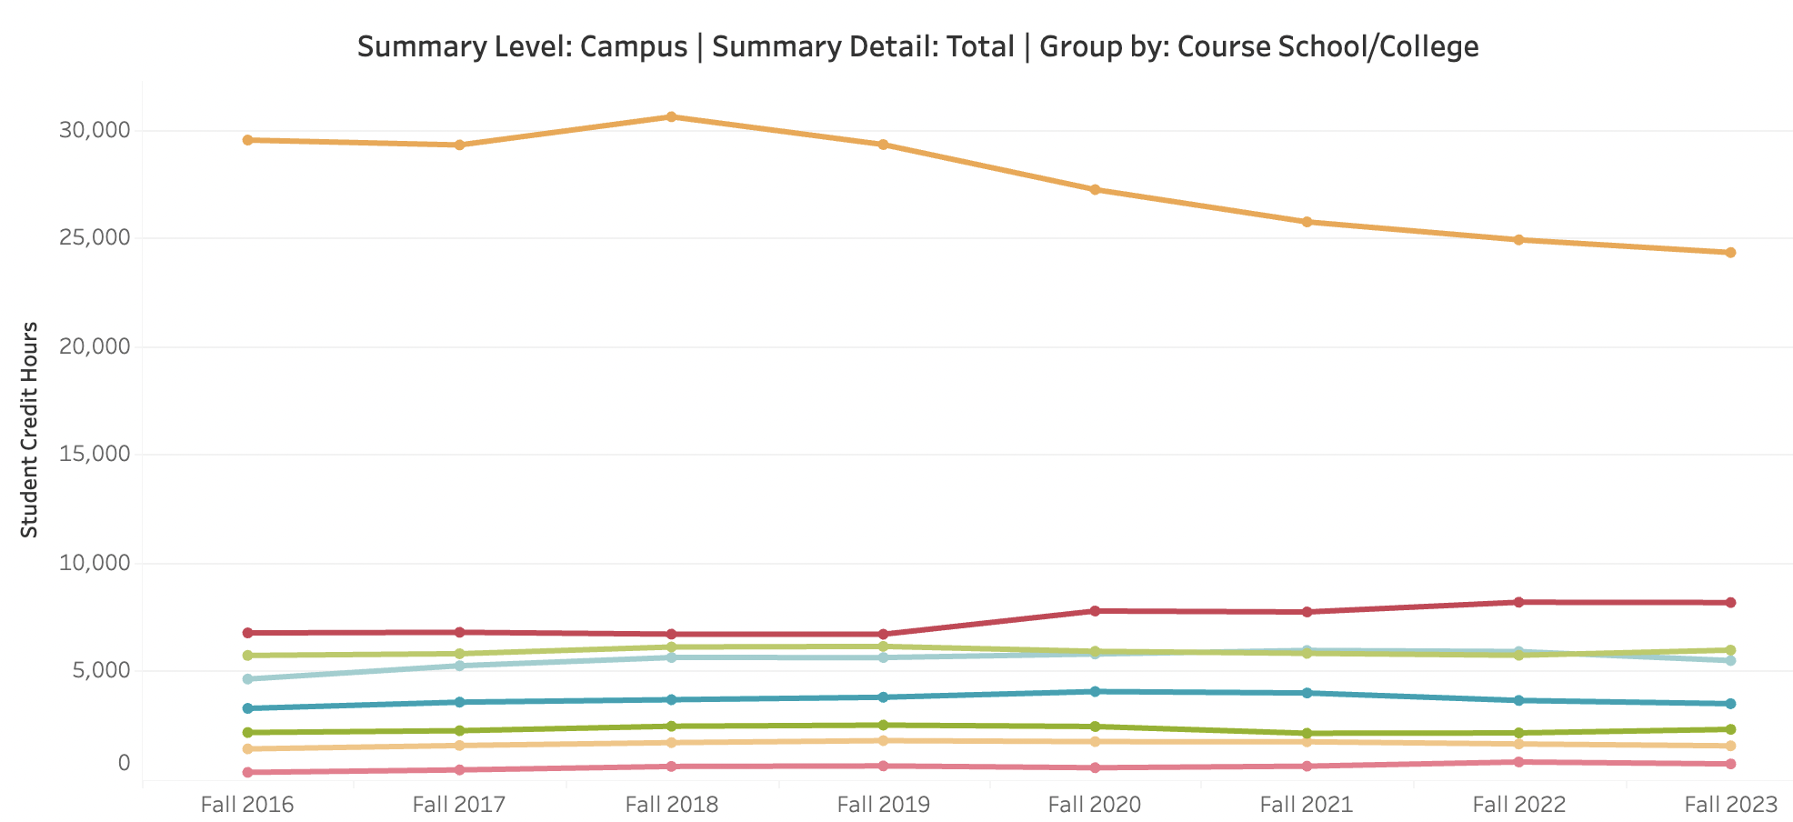
Methods
Ratio
Class
Budget
Studies have shown that the most effective student to teacher ratio is 18:1
According to the census, there are different number of classes needed to be taught in each school
We estimate that CU Denver has set aside $180,000,000 for professor salaries

Slide 5
Formulation
Parameters:
s_{i} = # students in each school i
r = maximum ratio willing to accept
p_{i} = average salary of professors in each school i
max_budget = maximum budget for the entire university
c_{i} = avg. # of classes each professor has to teach in each school i
a_{i} = minimum # of classes required for each school
Sets:
S = the schools in CU Denver {business, architecture and planning, liberal arts and sciences, arts and media, education and human development, engineering, public affairs}
Decision Variables:
x_{i}= # of teachers hired in each school i, ∀i∈S

Slide 6
Formulation
Objective Function:
Minimize ∑x_{i}
Constraints:
r * x_{i} ≥ s_{i} (Ratio Constraint)
∑p_{i} * x_{i} max_budget (Salary Budget Constraint)
c_{i} * x_{i} ≥ a_{i} (Class Constraint)
x_{i} ≥0 (Non-negativity)

Slide 7
Our Data
Students:
14,509 total
3.1% in Architecture
9.6% in Arts and Media
16.6% in Business
8.8% in Engineering
3.4% in Public Affairs
56.8% in Liberal Arts and Sciences
1.7% in Education and Human Development
Ratio: 18:1
Average Salary:
$95k in Architecture
$70k in Arts and Media
$101k in Business
$109k in Engineering
$84k in Public Affairs
$92k in Liberal Arts and Sciences
$73k in Education and Human Development

Slide 8
Our Data
Max Budget: $180 million
Average Classes to Teach:
2 in Architecture
3 in Arts and Media
2 in Business
3 in Engineering
1 in Public Affairs
3 in Liberal Arts and Sciences
1 in Education and Human Development
Minimum Classes to Teach:
96 in Architecture
246 in Arts and Media
307 in Business
154 in Engineering
231 in Public Affairs
1151 in Liberal Arts and Sciences
69 in Education and Human Development

Slide 9








Results
Total Number
Engineering
1113 Professors
71 Professors
Architecture
Public Affairs
48 Professors
231 Professors
Arts + Media
Liberal Arts
82 Professors
458 Professors
Business
Education
154 Professors
69 Professors

Slide 10
Conclusion and Further Work
Reasonable results:
Architecture (3.1:4.3)
Arts and Media (9.6:7.4)
Business (16.6:13.8)
Engineering (8.8:6.4)
Public Affairs (3.4:20.8)
Liberal Arts and Sciences (56.8:41.2)
Education and Human Development (1.7:6.2)
Future study:
Run our program for different universities and compare results
Add more complexity to the problem to more accurately represent it (i.e. Part time and Graduate students/professors)
Questions?

